Slide 1


Java Basics
Archer Infotech , PUNE
AMOL – 98222 91613
www.archerinfotech.in

Slide 2
Core Java

Slide 3
Java Singleton Class
In Java, Singleton is a design pattern that ensures that a class can only have one object.
To create a singleton class, a class must implement the following properties:
Create a private constructor of the class to restrict object creation outside of the class.
Create a private attribute of the class type that refers to the single object.
Create a public static method that allows us to create and access the object we created. Inside the method, we will create a condition that restricts us from creating more than one object.

Slide 4
Java Enum
The Enum in Java is a data type which contains a fixed set of constants.
In Java, enum types are considered to be a special type of class
When we create an enum class, the compiler will create instances (objects) of each enum constants. Also, all enum constant is always public static final by default.
In Java, enum was introduced to replace the use of int constants.

Slide 5
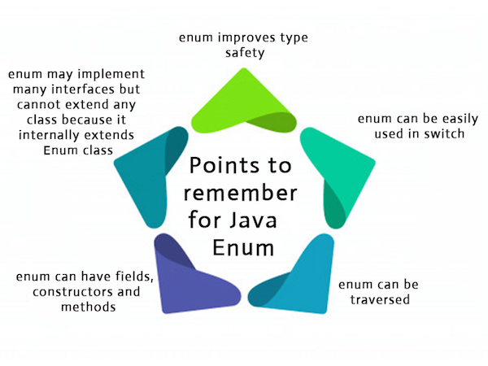
Java Enum

Slide 6
THANK YOU !!!
AMOL - 9822291613

